Slide 1
Personality Test Clustering
Use of Unsupervised Machine Learning to discern various personality types
Team members:
Michalis Kontis
Panagiotis Apostolou

Slide 2
Why?
Some examples:
It will benefit the HR and recruiters to estimate candidates better
Many professions like teachers, law enforcers, medical stuff require specific personality traits

Slide 3
Dataset
Questionnaire with 50 questions
Collected online by Open Psychometrics.
More than 1 million participants from more than 200 countries

Slide 4
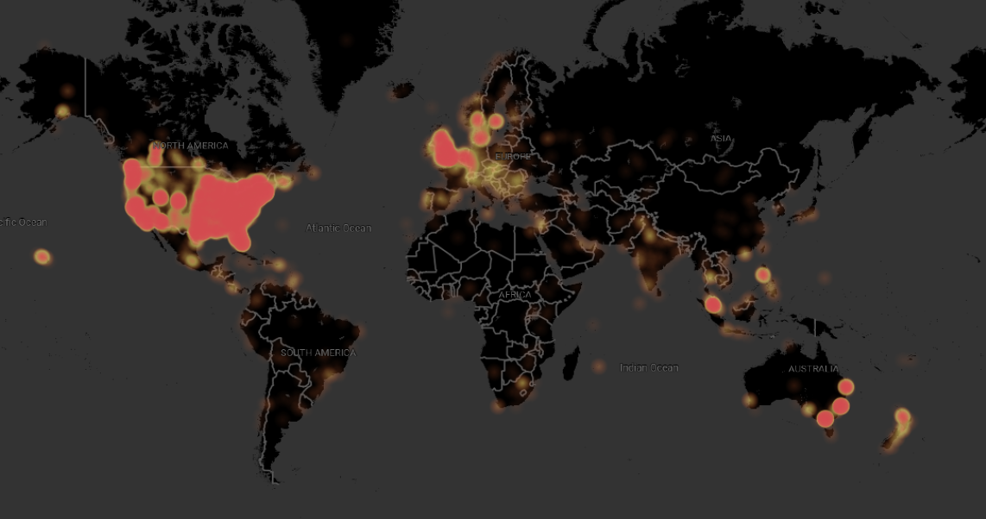

Slide 5
Method approach
We tried various machine learning methods to find the best way to group data.
Many methods lead to useful insights.
We found out that k-means and dendrograms suggest 4,8,9 clusters (next slide)

Slide 6
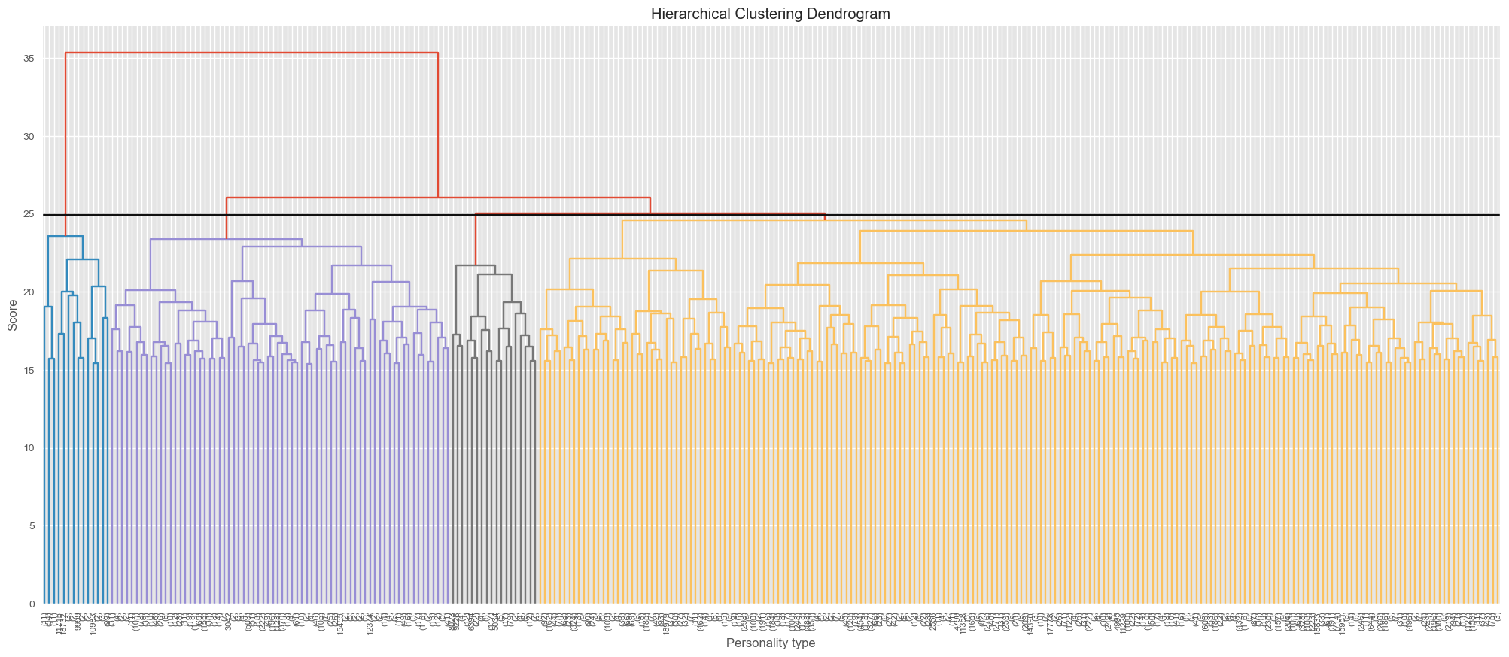
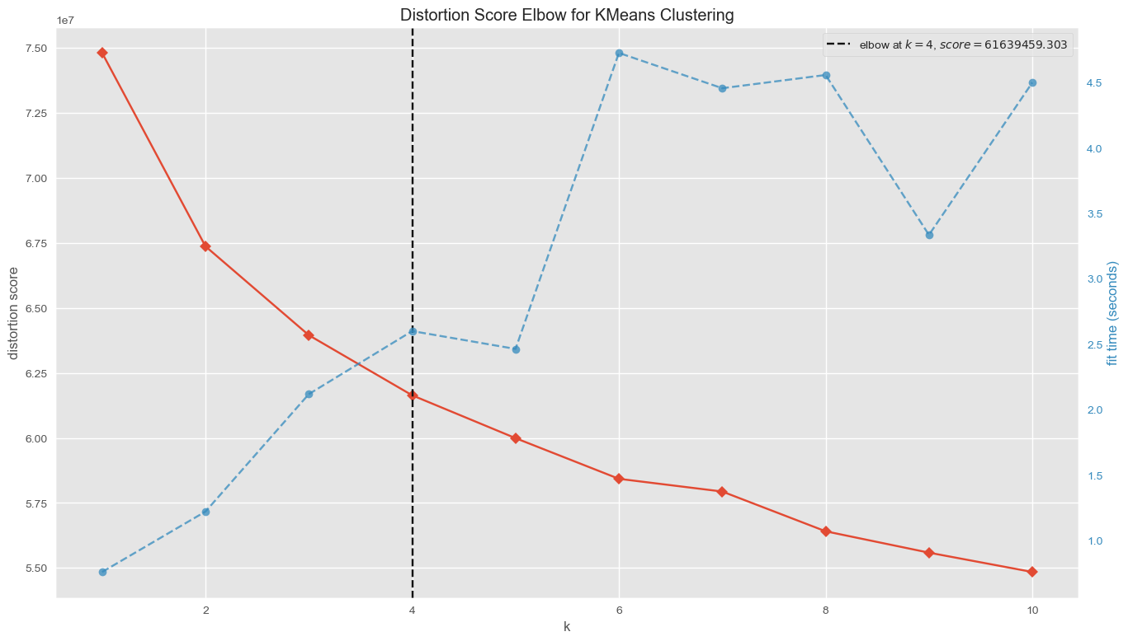
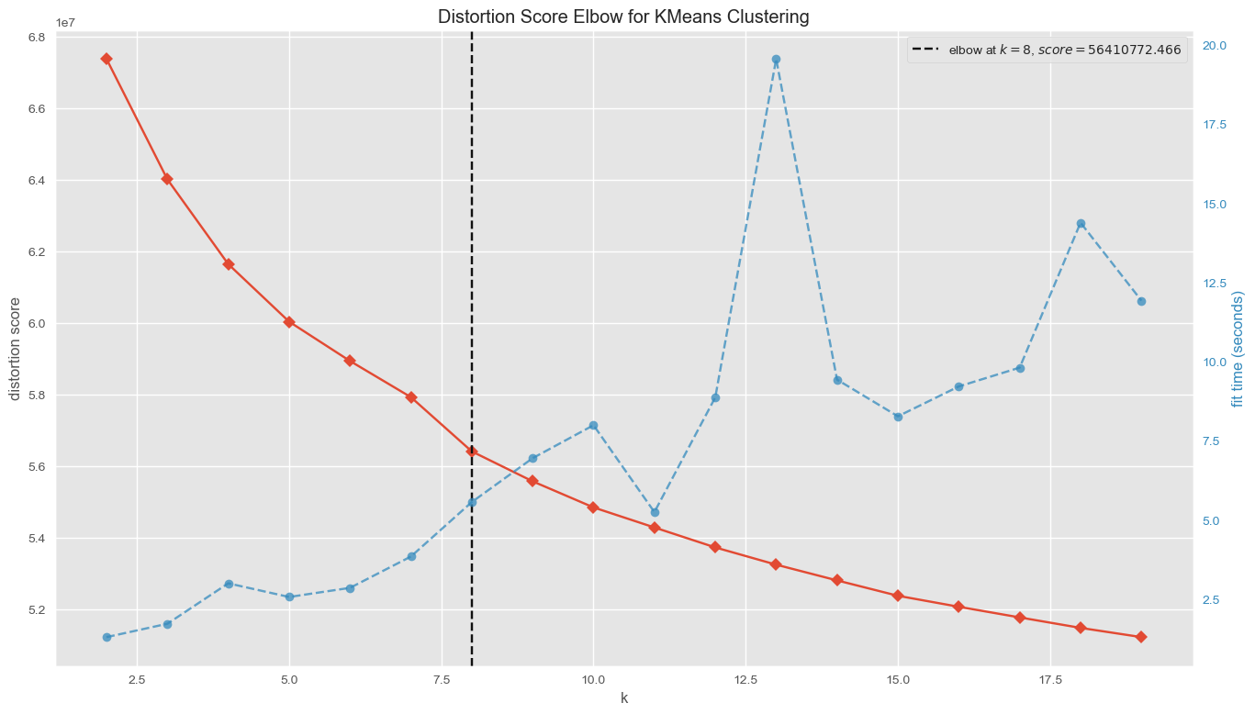
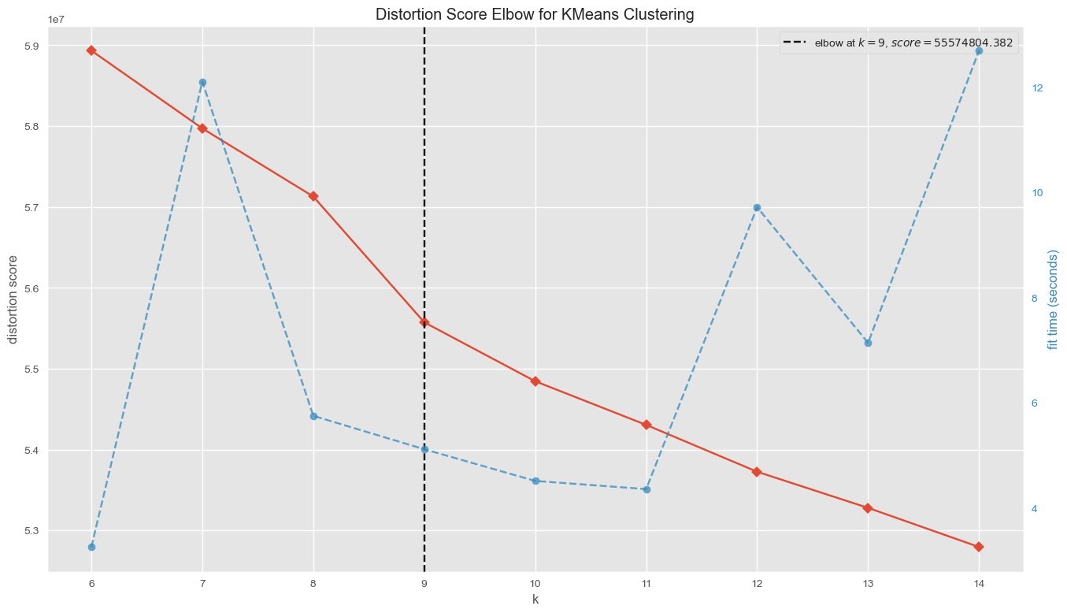
Horizontal line creates 4 clusters
4 clusters
8 clusters
9 clusters

Slide 7
We tested for all cluster options

Slide 8
4 Clusters

Slide 9
8 clusters
9 clusters

Slide 10
What personality trait exist in each cluster?

Slide 11
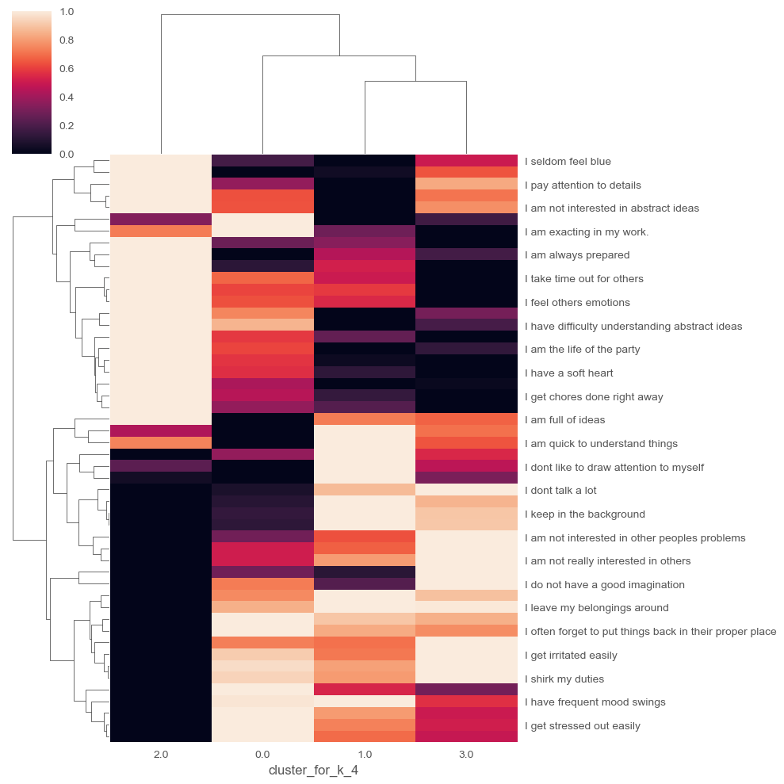
4 clusters

Slide 12
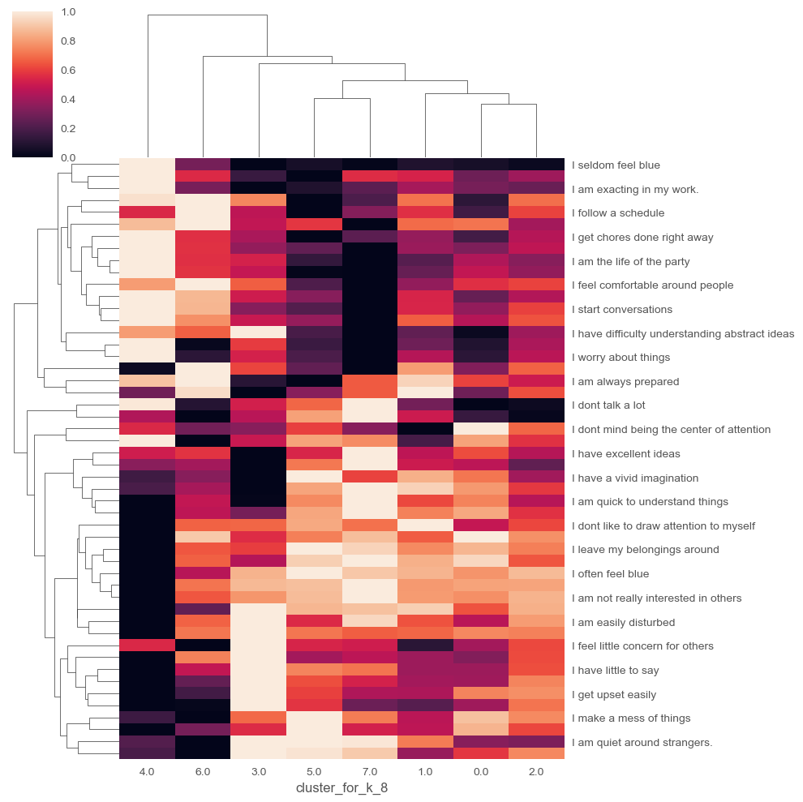
8 clusters

Slide 13
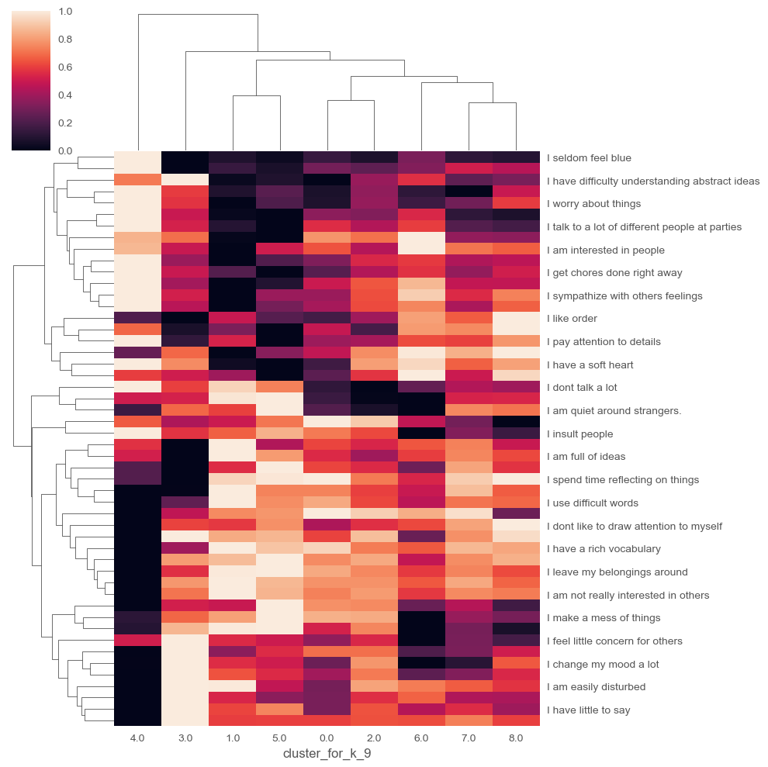
9 clusters

Slide 14
Summary
An online survey/questionnaire is good to extract data, especially if the sample size is large.
Different numbers of clusters give different point of view (based on patterns)
Nevertheless each option is not wrong
4 clusters option gives us a better clarified and more readable review

